Slide 1


Responses of wood anatomical parameters to changes in climate and the environment: progress, limitations, and challenges
Achim Bräuning
Institute of Geography, Friedrich-Alexander University Erlangen-Nürnberg
achim.braeuning@fau.de
Lecture at XTBG, October 24, 2017

Slide 2
Concepts and relevance of the topic
Methodological aspects
Environmental signals in qualitative wood anatomical traits
Environmental signals in quantitative wood anatomical traits
Constraints and Challenges
Outlook and Conclusions

Slide 3
Concepts and relevance of the topic
Methodological aspects
Environmental signals in qualitative wood anatomical traits
Environmental signals in quantitative wood anatomical traits
Constraints and Challenges
Outlook and conclusions

Slide 4
Use of Tree-Ring Data in Environmental Reconstructions
For reconstructions of past climate variability, time series of different tree-ring parameters (ring width, max. wood density, stable isotope ratios) are commonly used, mostly using annual resolution. Therefore, old trees or composite long chronologies are desired to enable time series analyses (trends, extreme year analysis, power spectra, wavelets, spatial correlations, etc.).
Hemispheric temperature from multiple proxies (Shi et al. 2013)
Spring temperature from ring width (Zhu et al. 2011a)
Summer temperature from wood density (Zhu et al. 2011b)
Summer humidity from tree-ring δ¹⁸O (Grießinger et al. 2011)
Notes:
Compilation of dating results from this and selected other studies, and paleoclimate reconstructions: (A) oldest-tree moraine dating results, this study, vertical black lines show the calculated germination date, (B) 14C dating result, this study, light grey bars indicate alternative interpretations of the result which are invalidated by morphological constraints, (C) oldest-tree moraine dating results younger than 1800 CE from selected other studies (see text), 1 Lhamcoka (Bräuning and Lehmkuhl, 1996), 2 Lhamcoka (Bräuning 2006), 3 Gawalong, only terminal moraine crest positions (Zhu et al., 2013), 4 Midui, only terminal moraine crest positions (Xu et al., 2012), (D) temperature reconstruction for southeastern Tibet (Zhu et al., 2011; solid line is the 11 yr running mean), (E) reconstruction of summer precipitation anomalies from Reting (Grießinger et al., 2011; solid line is the 11 yr running mean), (F) multi-proxy reconstruction of northern hemisphere temperature anomalies (Shi et al., 2013; base period 1001–1960 CE, solid line is the 20 yr running mean), (G) reconstruction of volcanic forcing derived from ice core sulphate (Crowley and Unterman, 2013), (H) 14C based reconstruction of solar modulation (Muscheler et al., 2007; solid line is the 20 yr running mean), (I) reconstructed sun activity (Steinhilber et al., 2009).

Slide 5
Principal considerations concerning the wood anatomy of a plant Traits, properties, and performance: how woody plants combine hydraulic (blue bubbles) and mechanical (red bubbles) functions in a cell, tissue, or whole plant
In an evolutionary sense, the selection of a plant individual is based on its performance, not on certain structures or traits.
The anatomy of a plant is not independent from its phylogenetic inheritance, meaning the position within the plant kingdom (e.g., softwood or hardwood anatomy).
Wood anatomical and plant morphological features can only vary within certain response limits.
(Linear) Responses to environmental factors are possible within the given genetic plasticity
Lachenbruch & McCulloh, New Phytologist, 2014

Slide 6

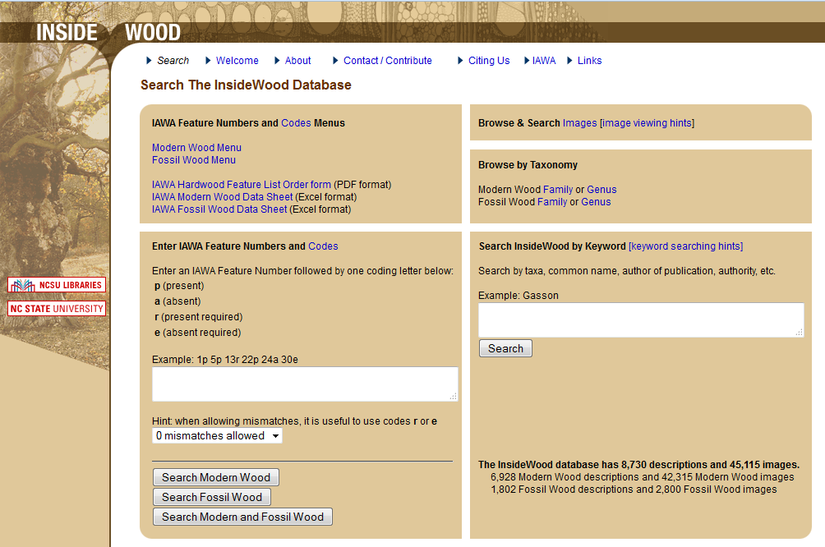
„Classical“ wood anatomy is characteristic for systematic units (sometimes species, sometimes genera or families) and is used for wood identification and analysis of systematic lineages
formerly: wood libraries (e.g. in Stuttgart-Hohenheim) https://www.uni-hohenheim.de/uniarch/Xylothek%20_%20Seite/Xylothek_index.html
e.g. Inside wood database: http://insidewood.lib.ncsu.edu/search;jsessionid=070DC5E24309464C44682438C576563D?0

Slide 7
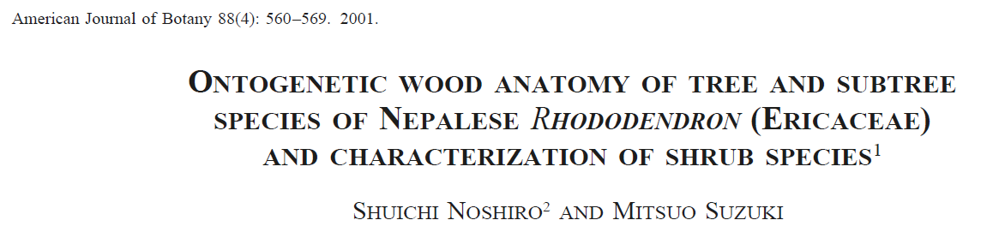
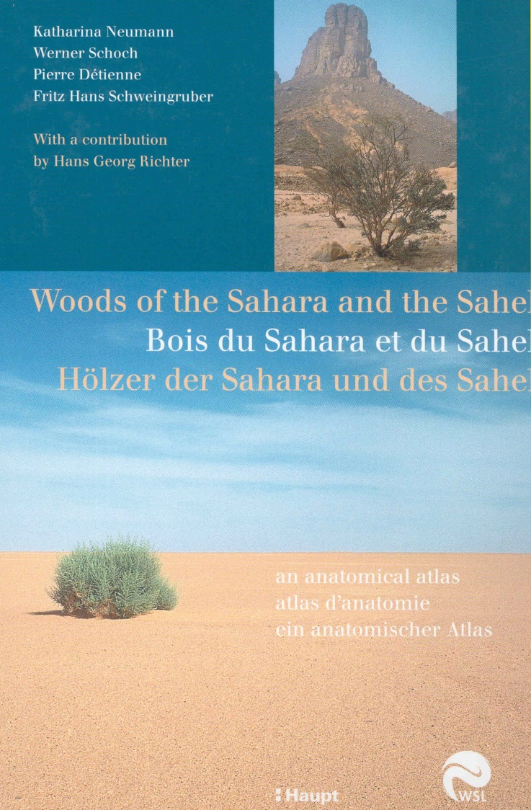
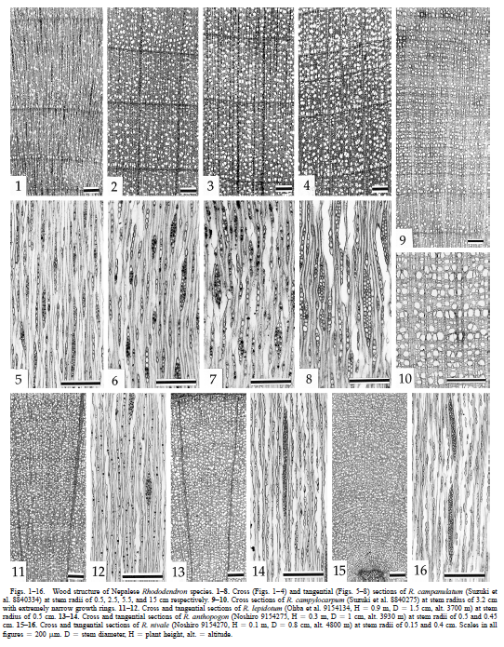
Applications in “classical” wood anatomy Analysis of phylogenetic development within plant taxa, description of regional floras

Slide 8
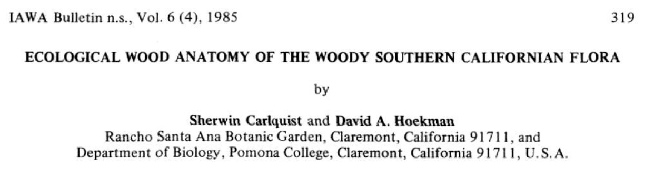
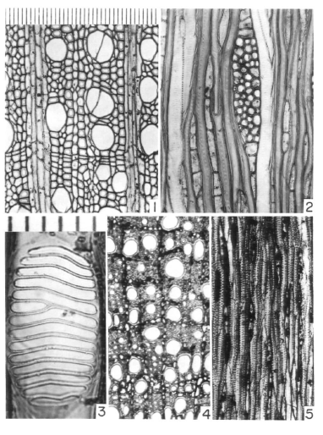
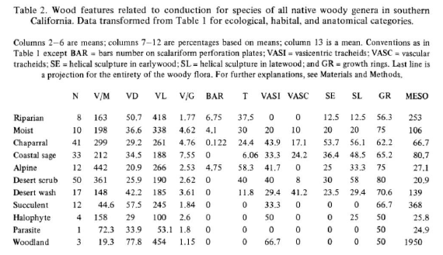
Development of “ecological” wood anatomy Analysis of environmental impact on wood anatomical features and traits

Slide 9
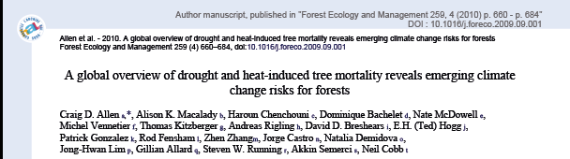
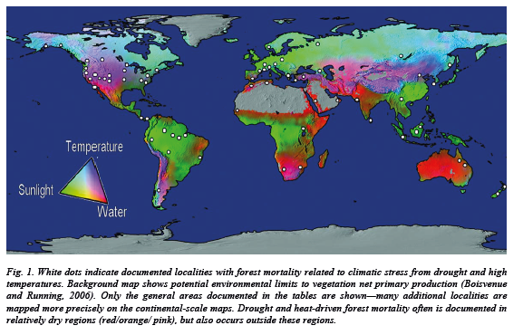
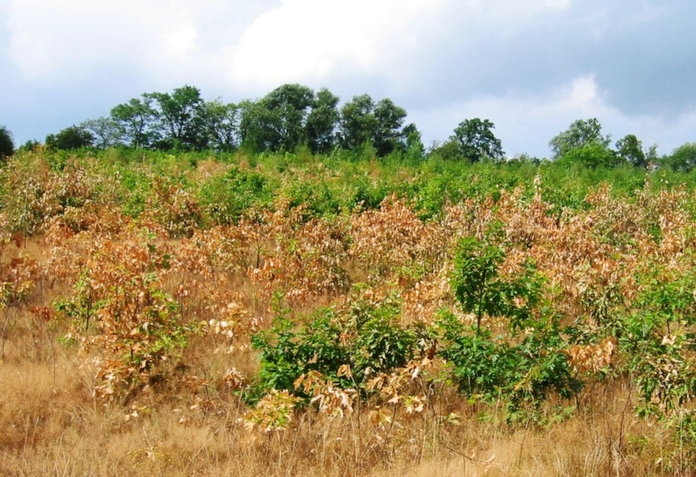

Slide 10
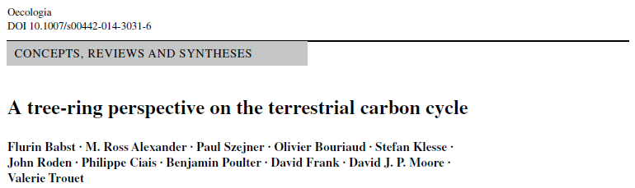
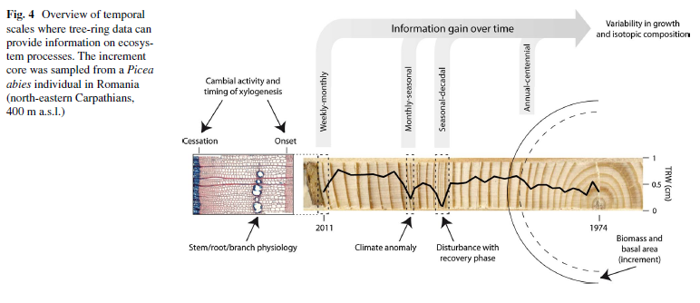

Slide 11
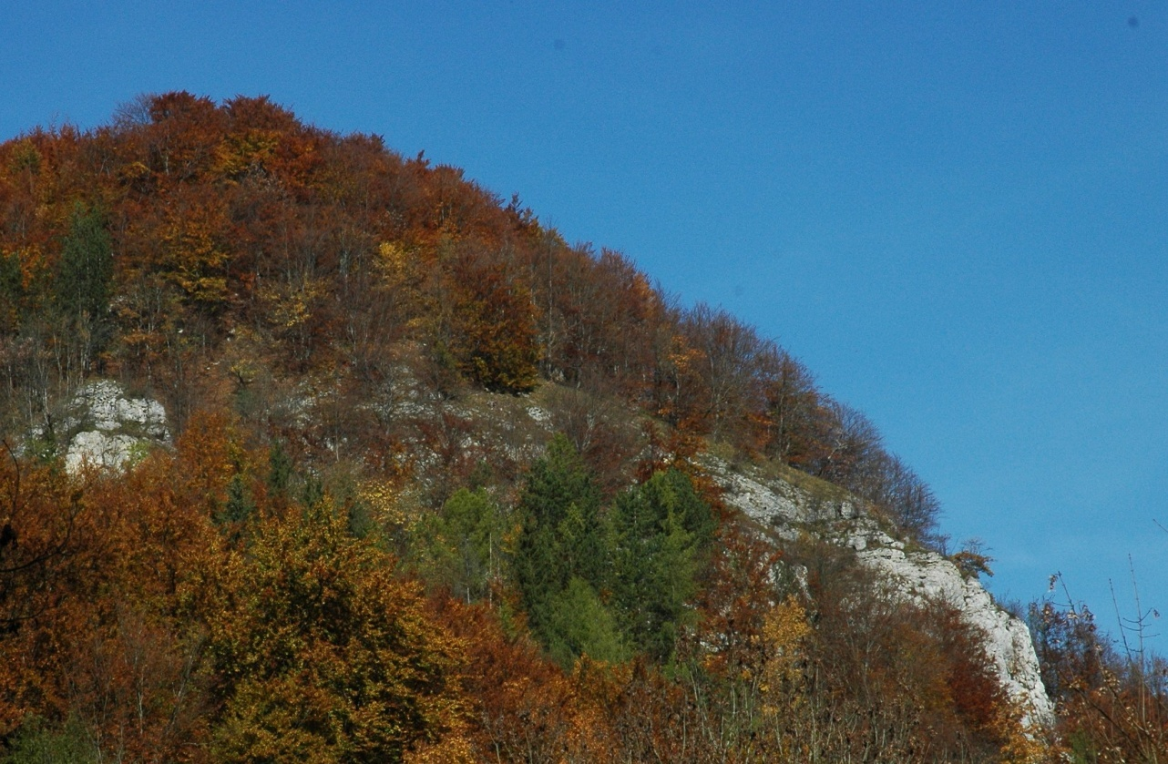
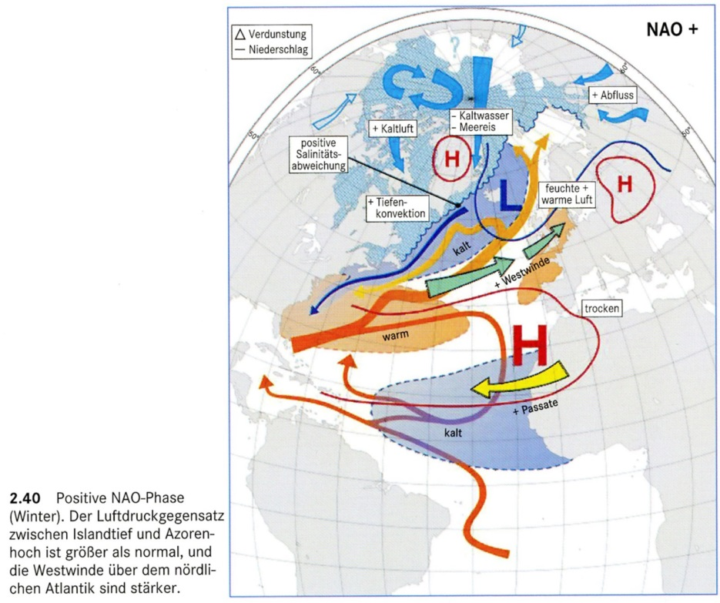
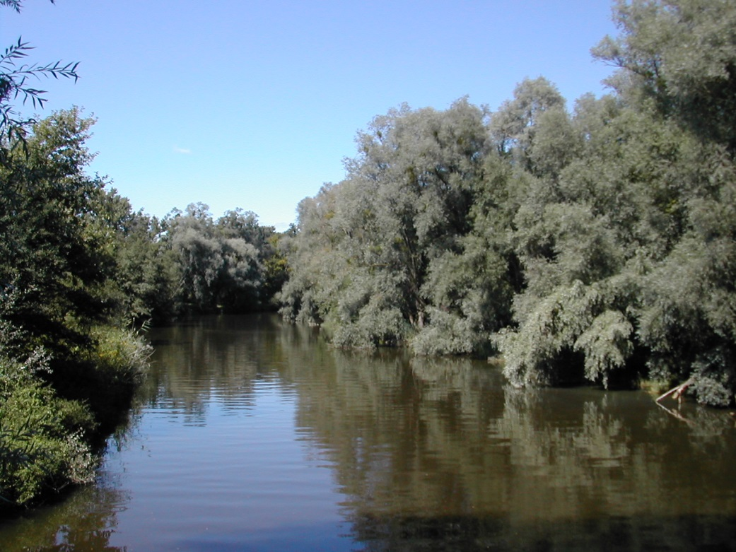
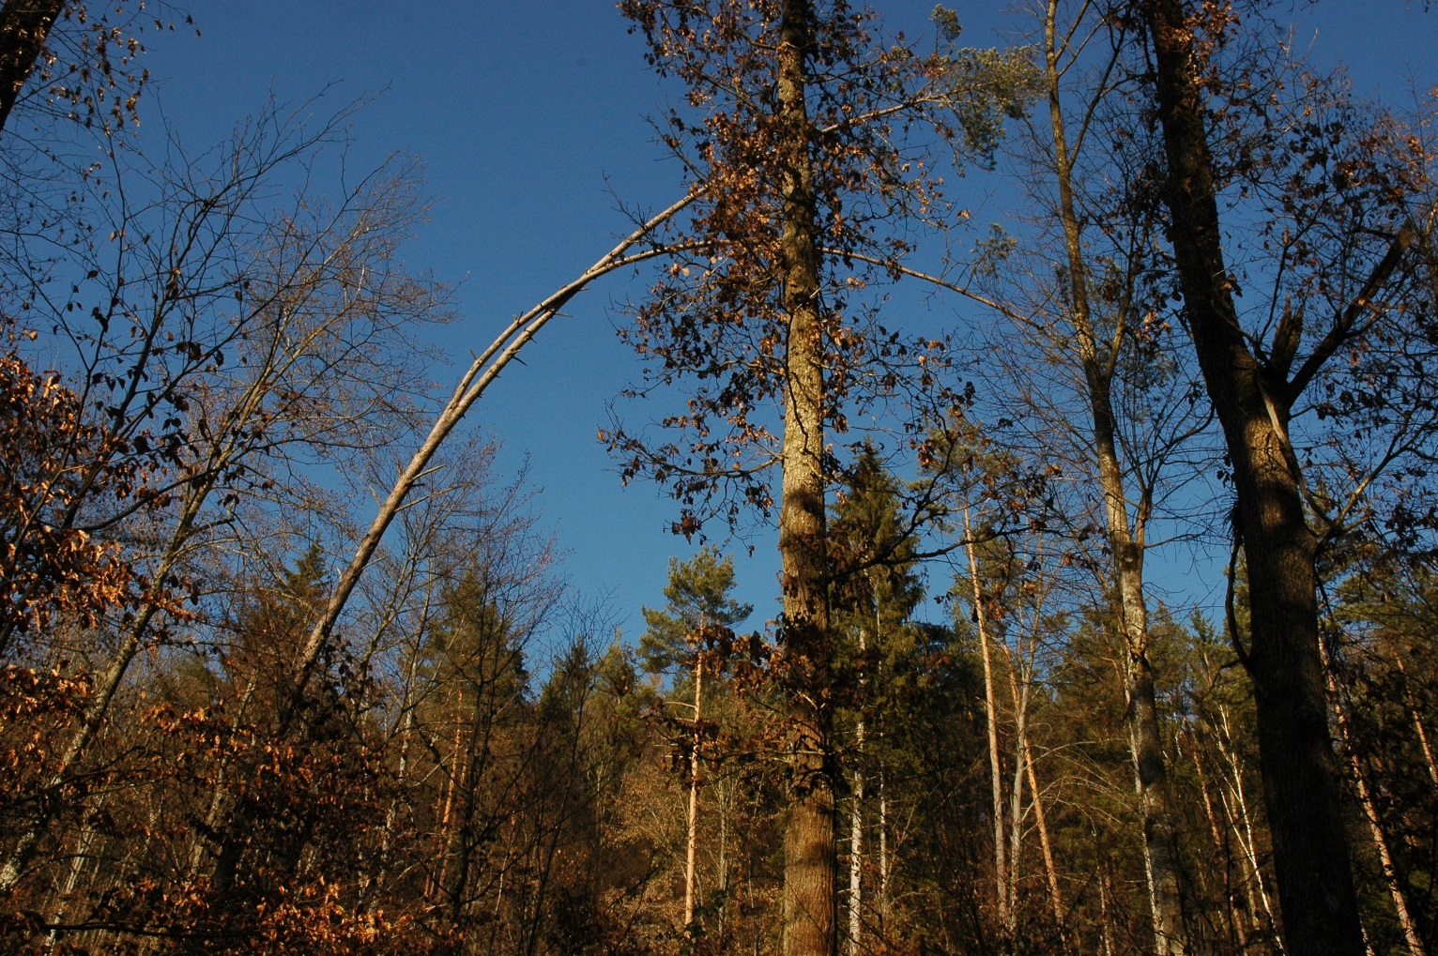
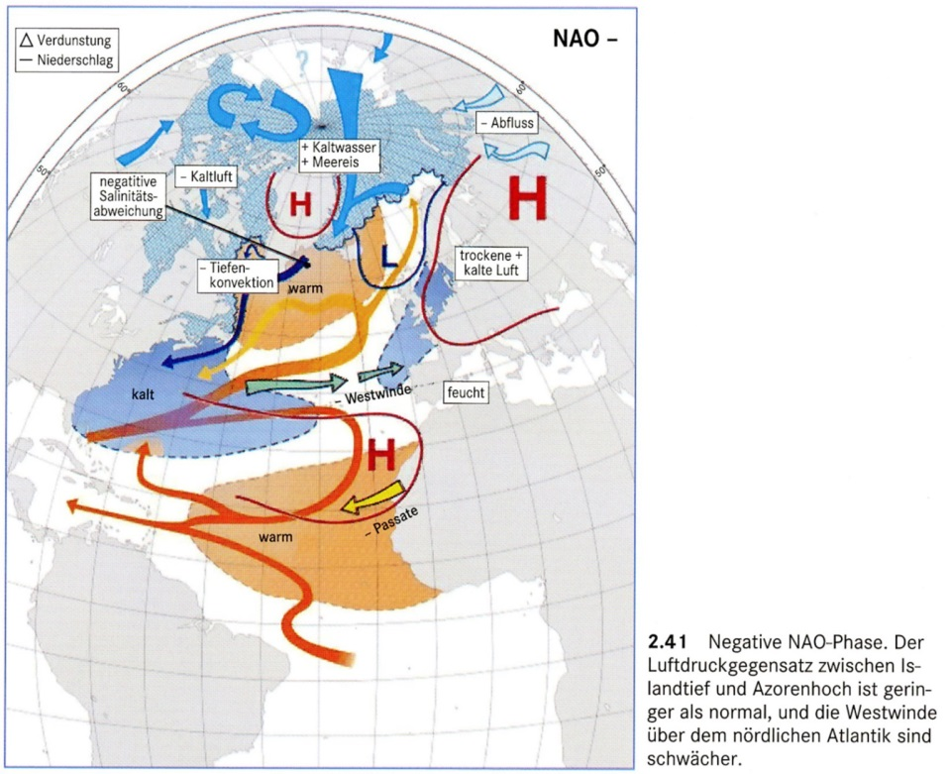
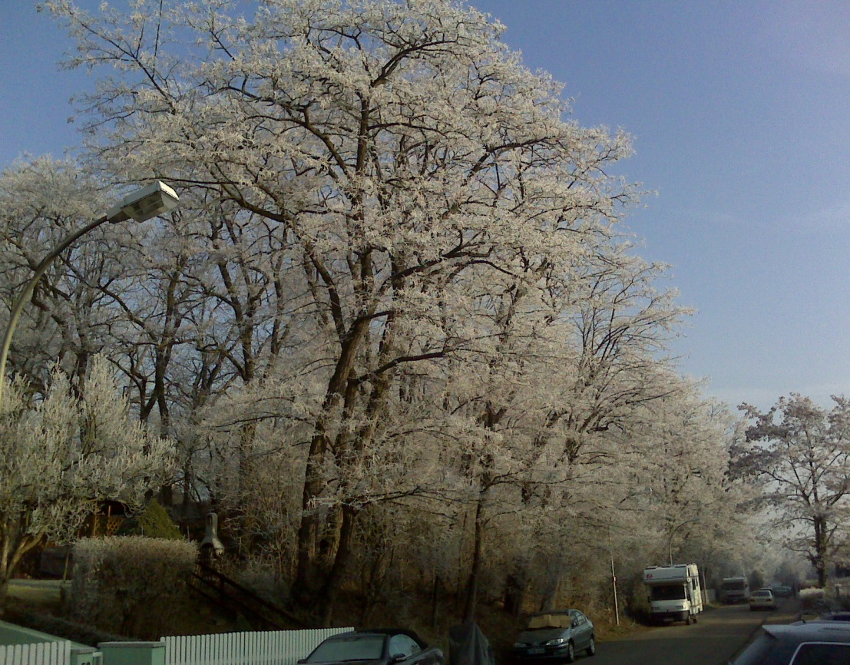
Drought
Flood
Frost
Storm
Kappas 2009

Slide 12
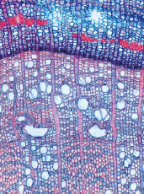
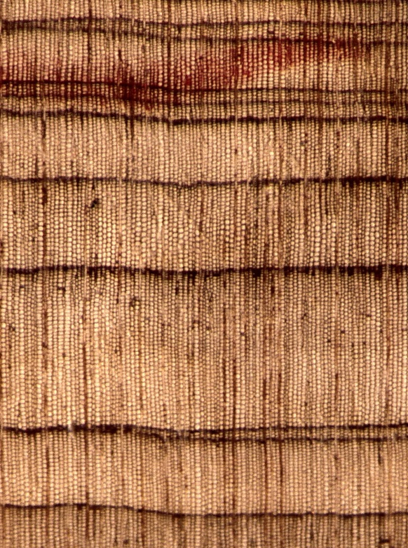
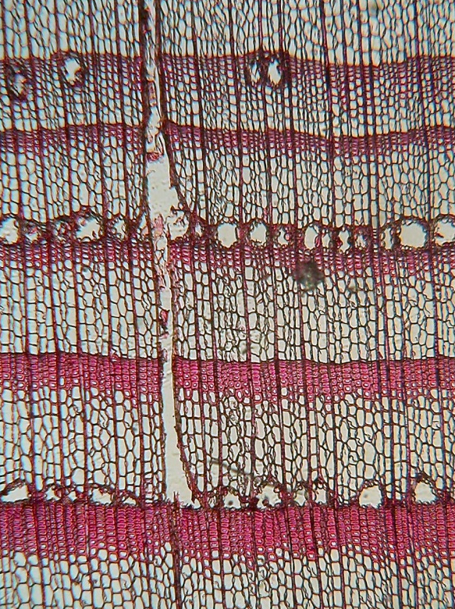
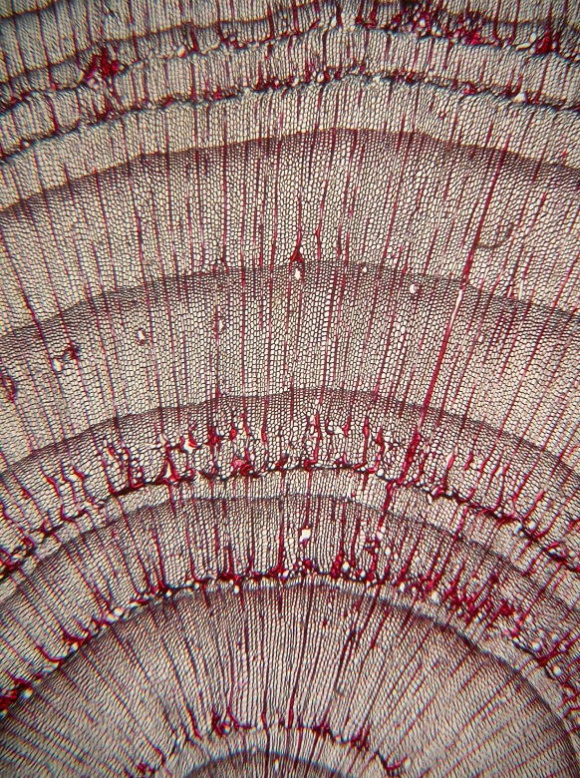
Drought
Flood
Copini et al., 2016
Frost
Storm
Kappas 2009

Slide 13

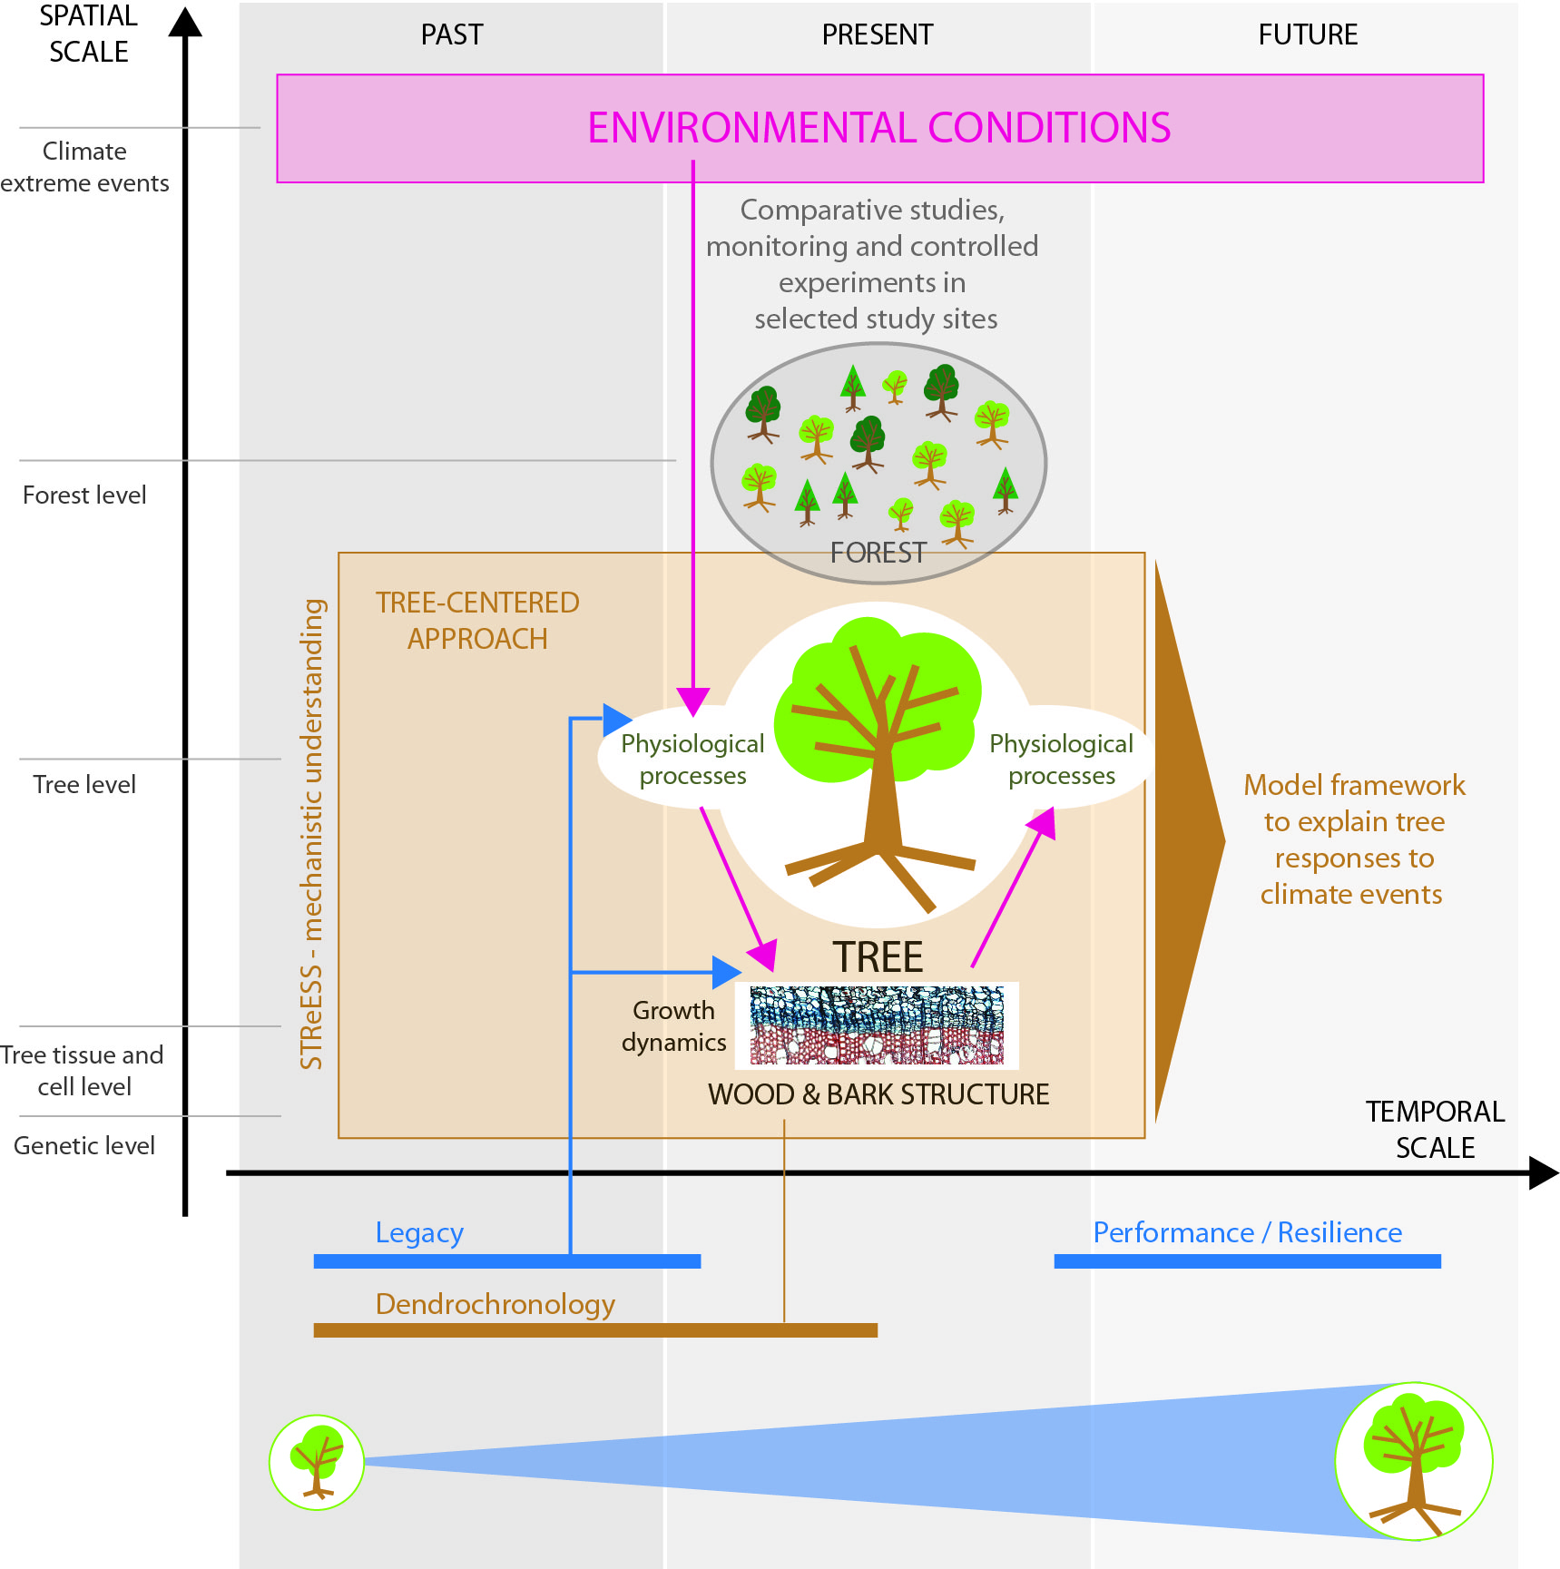
Studying Tree Responses to extreme Events: a SynthesiS
COST Action no. FP1106
Schematic of the tree-centered approach applied by STReESS to enhance mechanistic understanding. The approach consists of the following interlinked elements: [1] Environmental conditions affect physiological processes, which drive growth dynamics, and results in specific wood and bark structure. [2] Quantity and structure of newly formed wood as assessed by dendrochronology affects whole-tree physiological functioning and performance. [3] Legacy of past environmental conditions and extreme events is imprinted in wood structure, influencing tree functioning and todays’ tree performance. This is important to assess tree resilience ability. [4] Selection of comparative studies, monitoring and controlled experiments allow model testing and validation in specific contexts. All four elements are important to assess non-linear trigger-response relations and enable to create a model framework to explain and evaluate tree responses to climate events
Low temporal and spatial resolution measures changes in tree circumference
Price: 3,- to ca. 360,- € plus data logger)
Therefore high number of trees possible
Sass-Klaassen, et al. 2016: Frontiers in Plant Science

Slide 14
Concepts and relevance of the topic
Methodological aspects
Environmental signals in qualitative wood anatomical traits
Environmental signals in quantitative wood anatomical traits
Constraints and Challenges
Outlook and conclusions

Slide 15
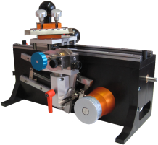
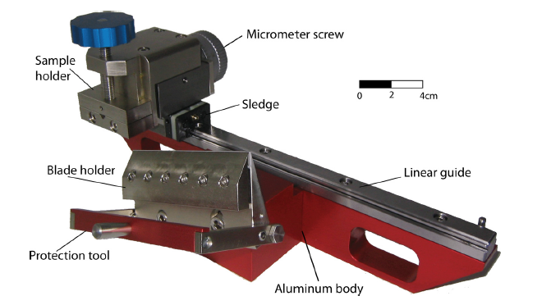
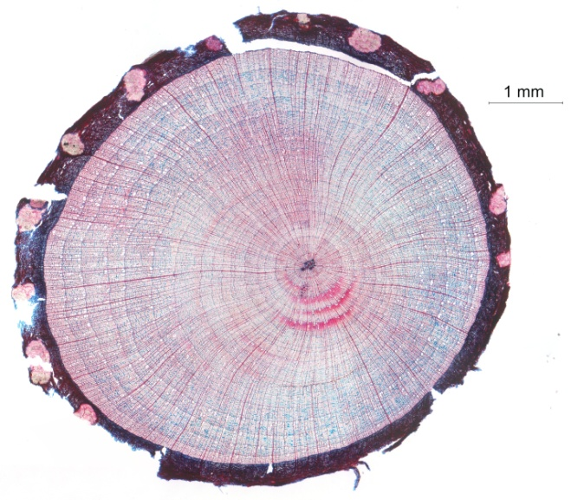
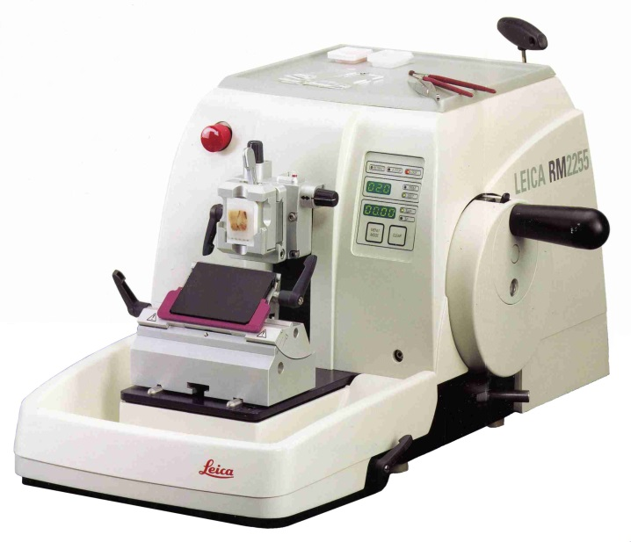
Creating samples for studying wood anatomy Microtomes and staining with safranin red (lignin) and astra blue (living tissues)
Sledge microtomes
Gärtner et al. 2014
Rotary microtome
Dendro Sciences Dendrobiology

Slide 16
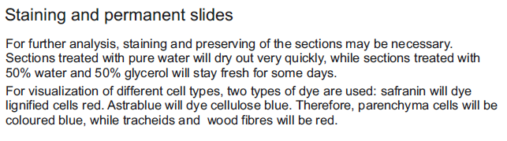
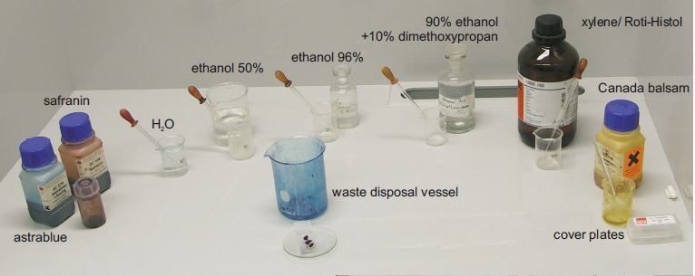
Creating samples for studying wood anatomy Microtomes and staining with safranin red (lignin) and astra blue (living tissues)

Slide 17
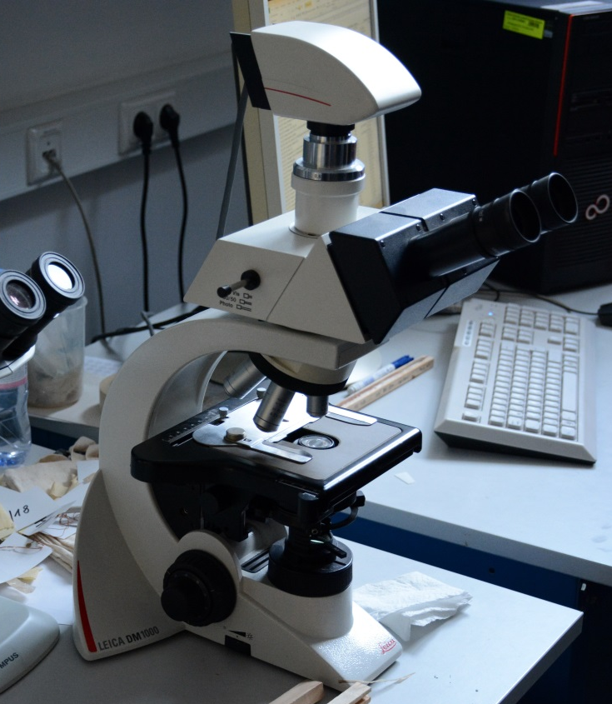
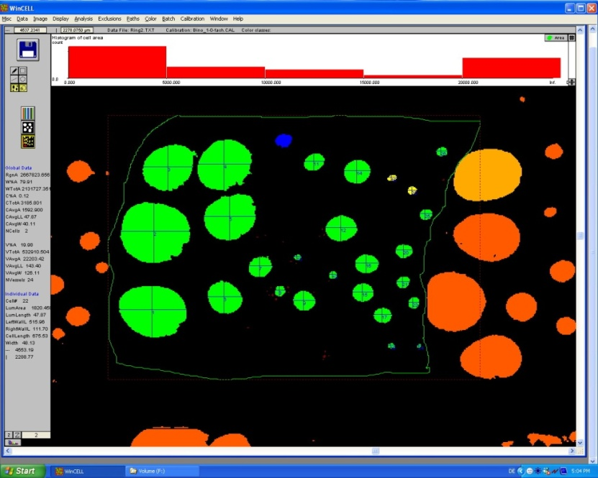
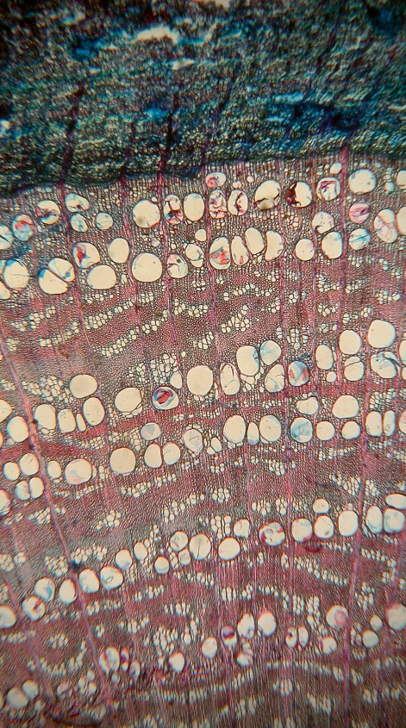
Classical standard procedure for quantitative wood anatomical studies:
Digital imaging of a wood microsection and ring-by-ring analysis in image analysis software (e.g., older versions of WinCell, ImageJ)

Slide 18
Recent Advancement of preparation methods:
The application of non-Newtonian fluids to stabilize wood samples allow the preparation of large high-quality wood microsections for image analysis.

Slide 19
Recent Advancement of preparation methods:
The application of non-Newtonian fluids to stabilize wood samples allow the preparation of large high-quality wood microsections for image analysis.

Slide 20
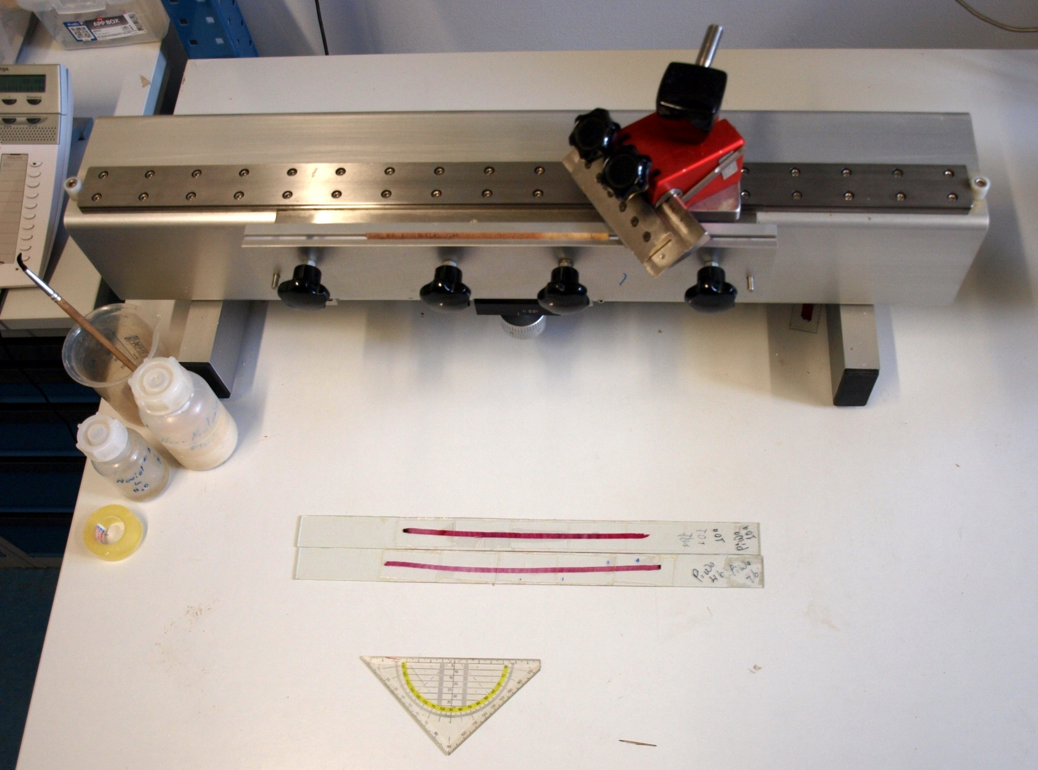
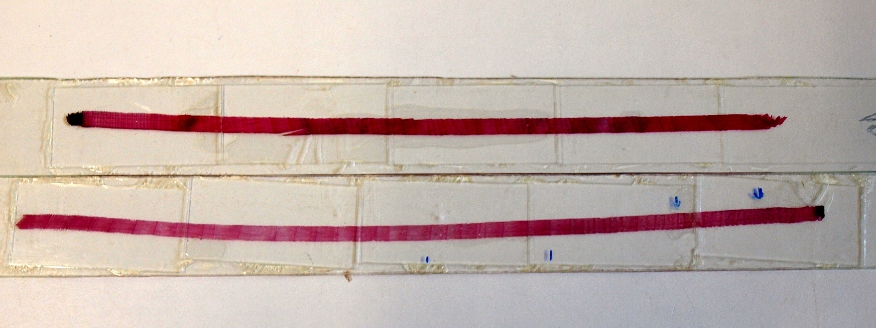
Recent Advancement of preparation methods:
The WSL core microtome and application of non-Newtonian fluids to stabilize wood samples allow the preparation of large high-quality wood microsections.

Slide 21
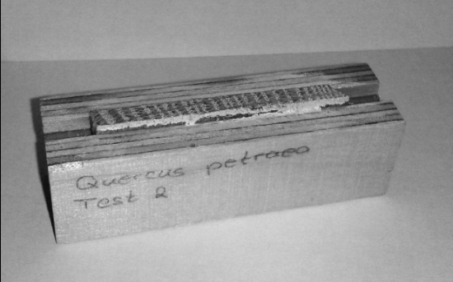
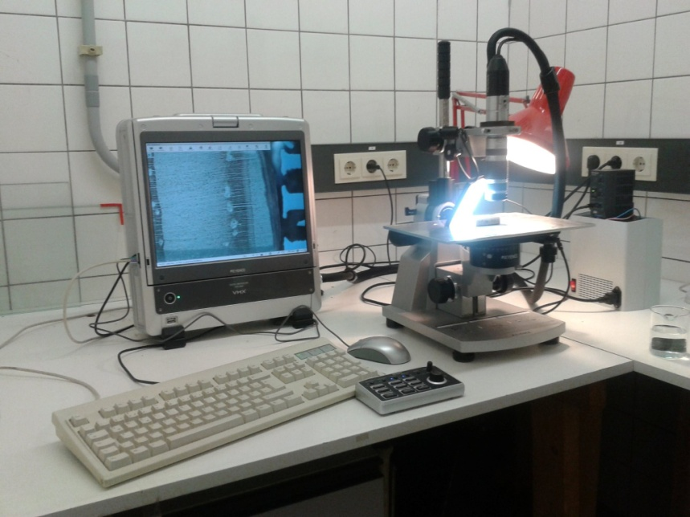
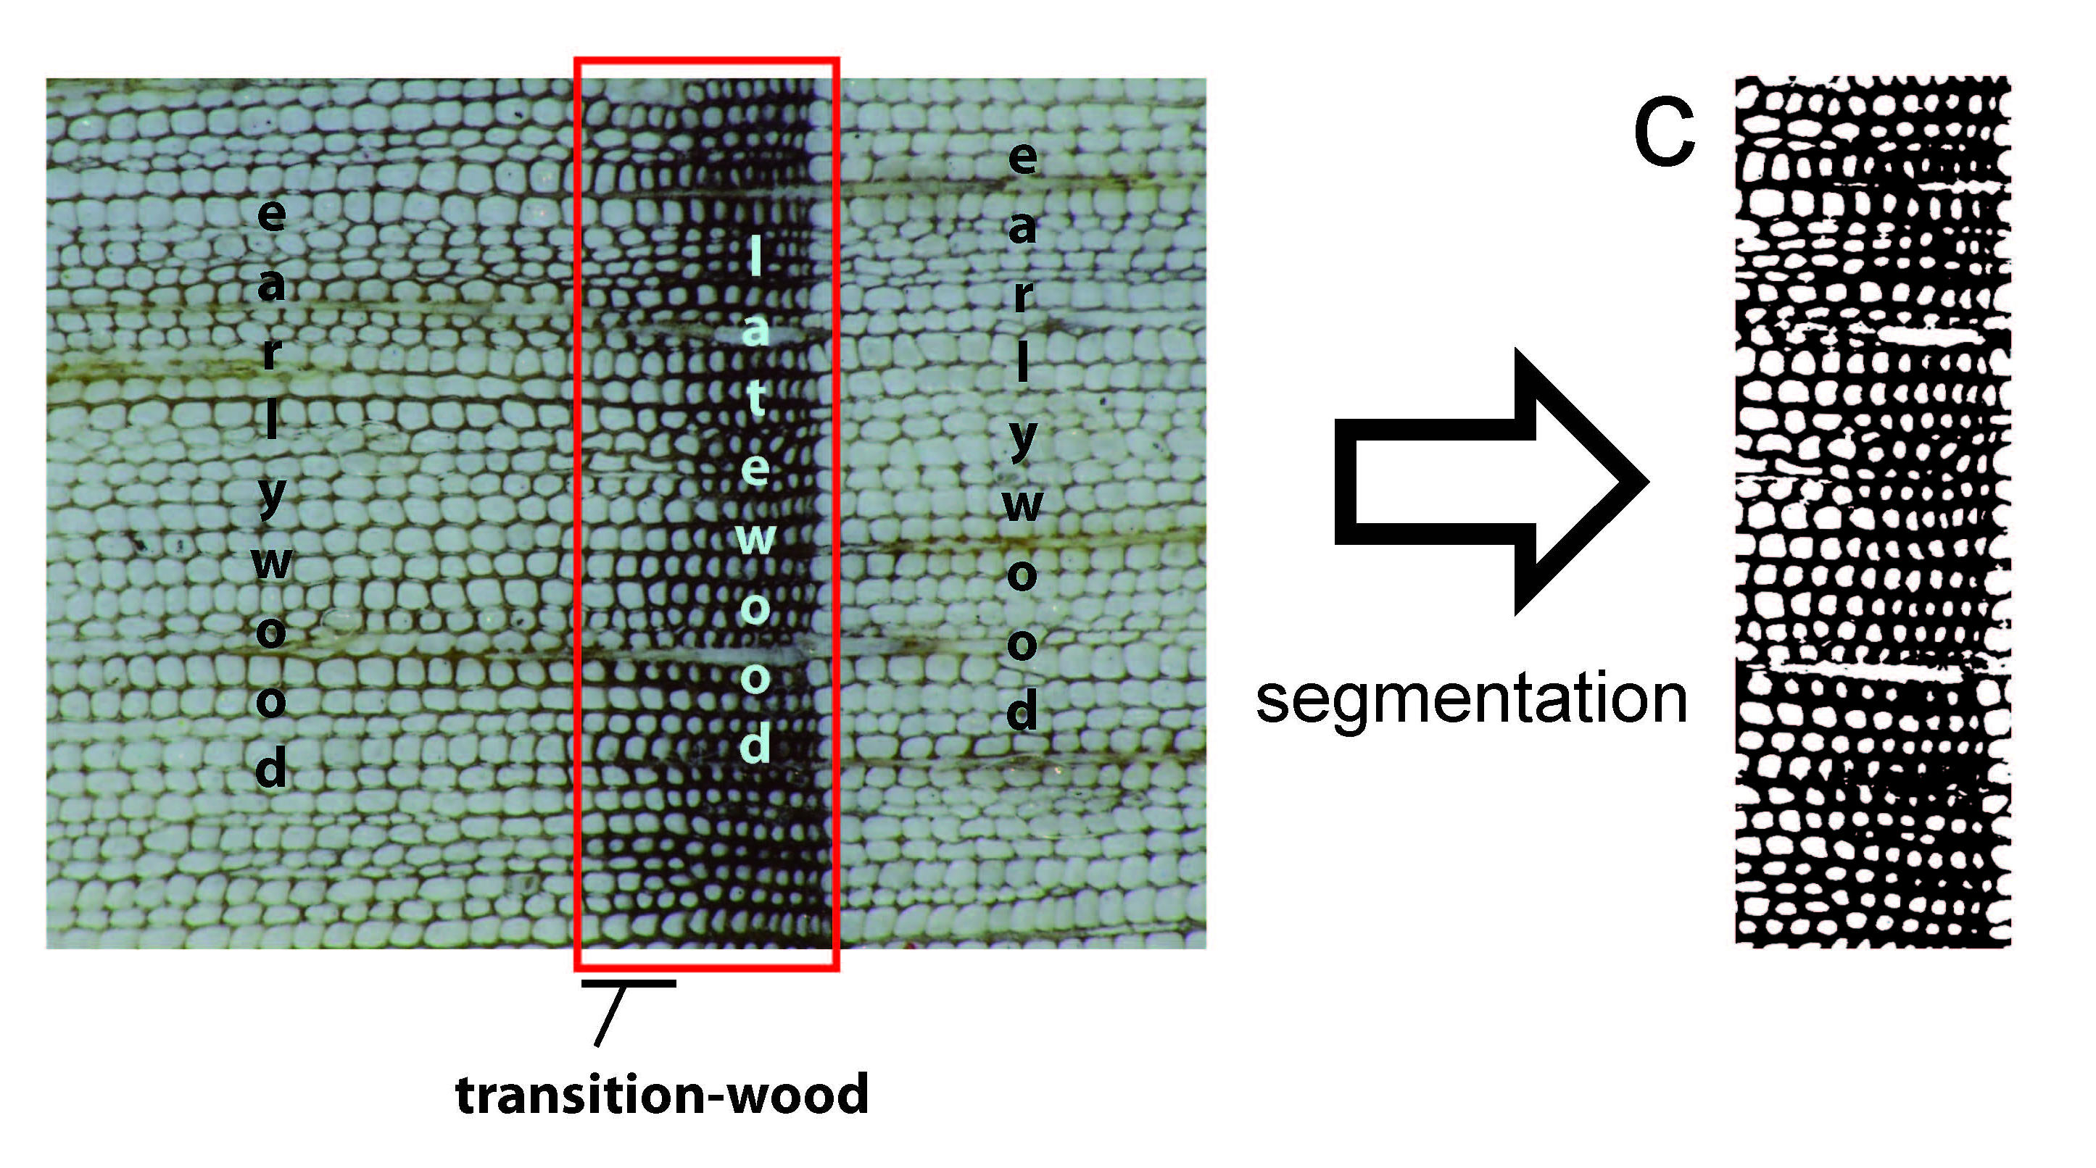
Recent Advancement of analysis methods:
Working with digital images created directly from a wood surface (Hetzer et al., 2014).
2. Microscopic images: Keyence VHX-500-F digital microscope
1. Mikrotoming, surface cleaning, Contrast enhancement
Image correction and analysis: WinCell Pro 2010
Data analysis: R-routines (partly self-developed)
Advantage: time to analyze one tree ring:
Surface preparation: < 1 minute
Microsectioning: 2-10 minutes
3. Image Processing (Adobe Photoshop CS2/3/4)

Slide 22
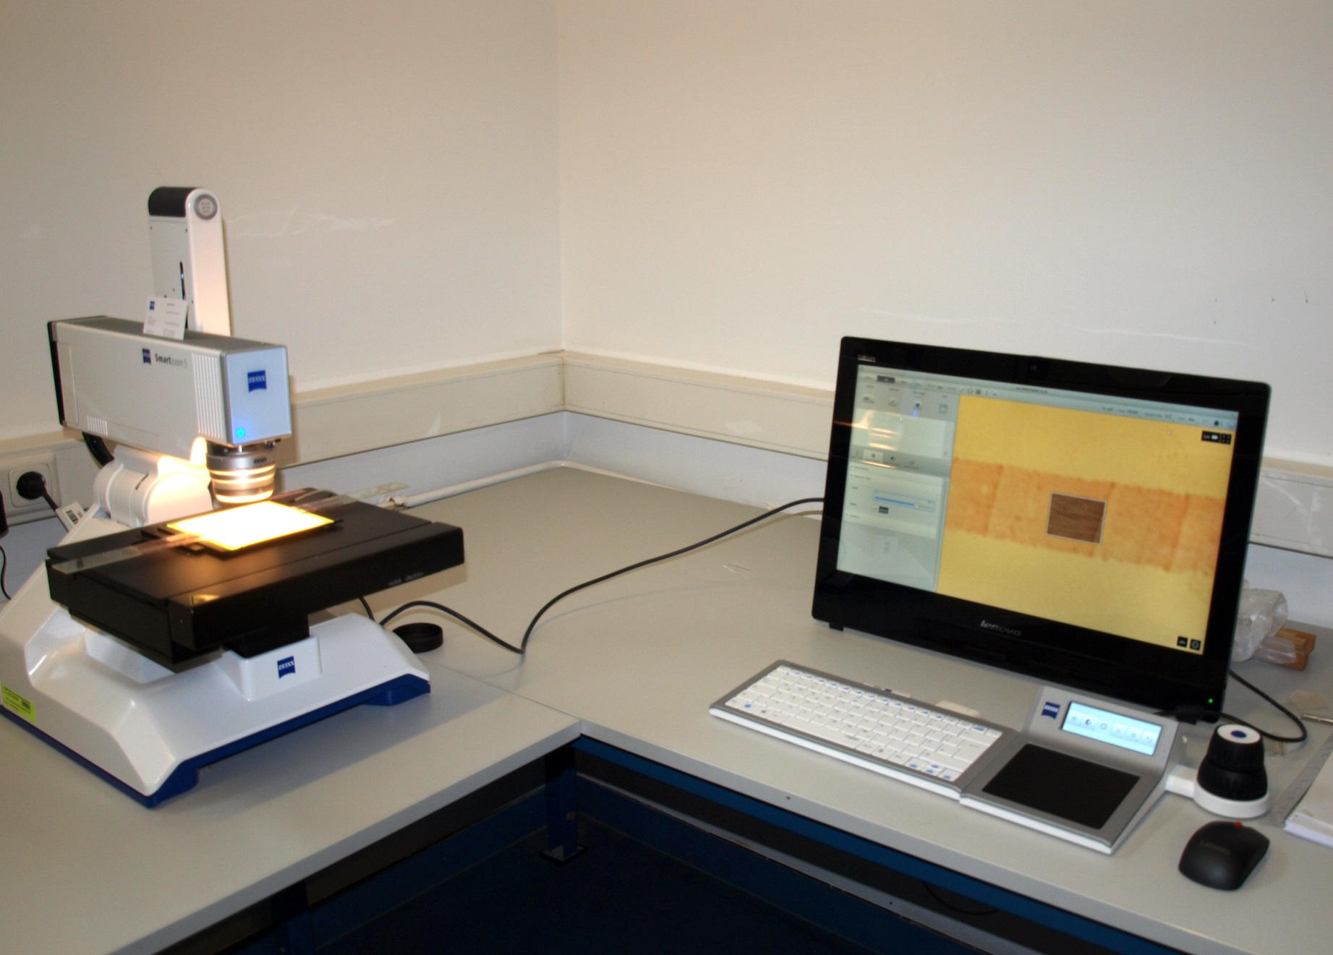
Recent Advancement of analysis methods:
Working with digital microscopes with stitching facility and image processing.
ZEISS Smartzoom 5

Slide 23
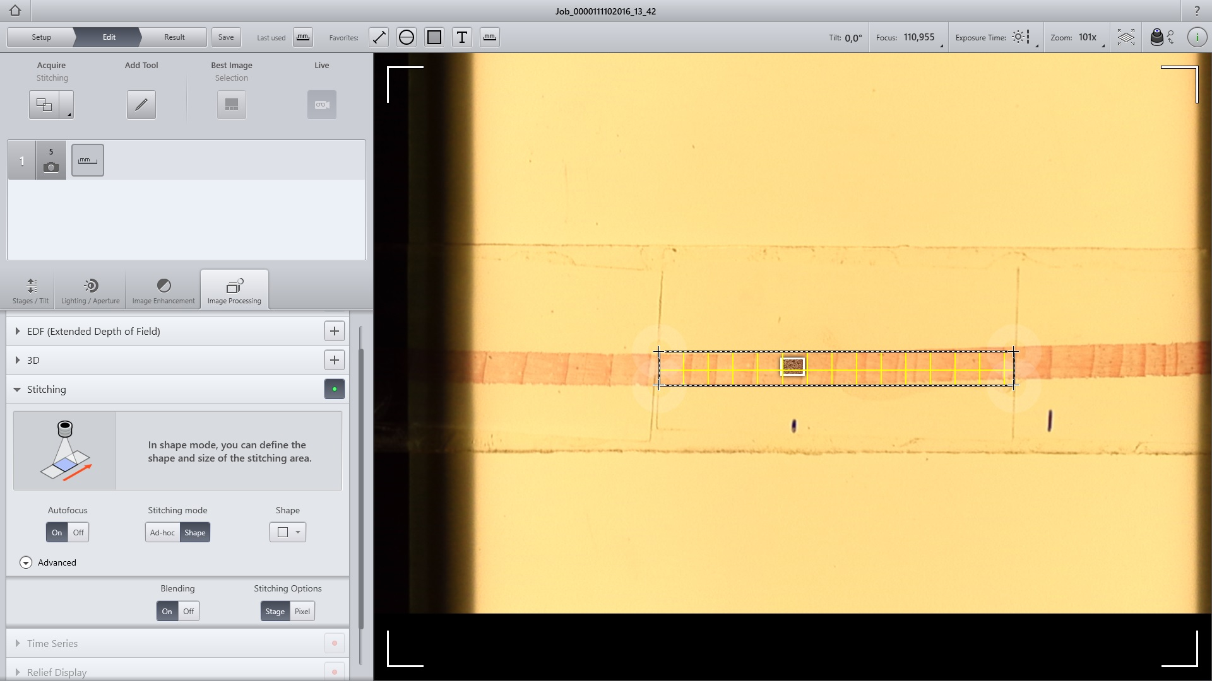
Recent Advancement of analysis methods:
Working with digital microscopes with stitching facility and image processing.

Slide 24
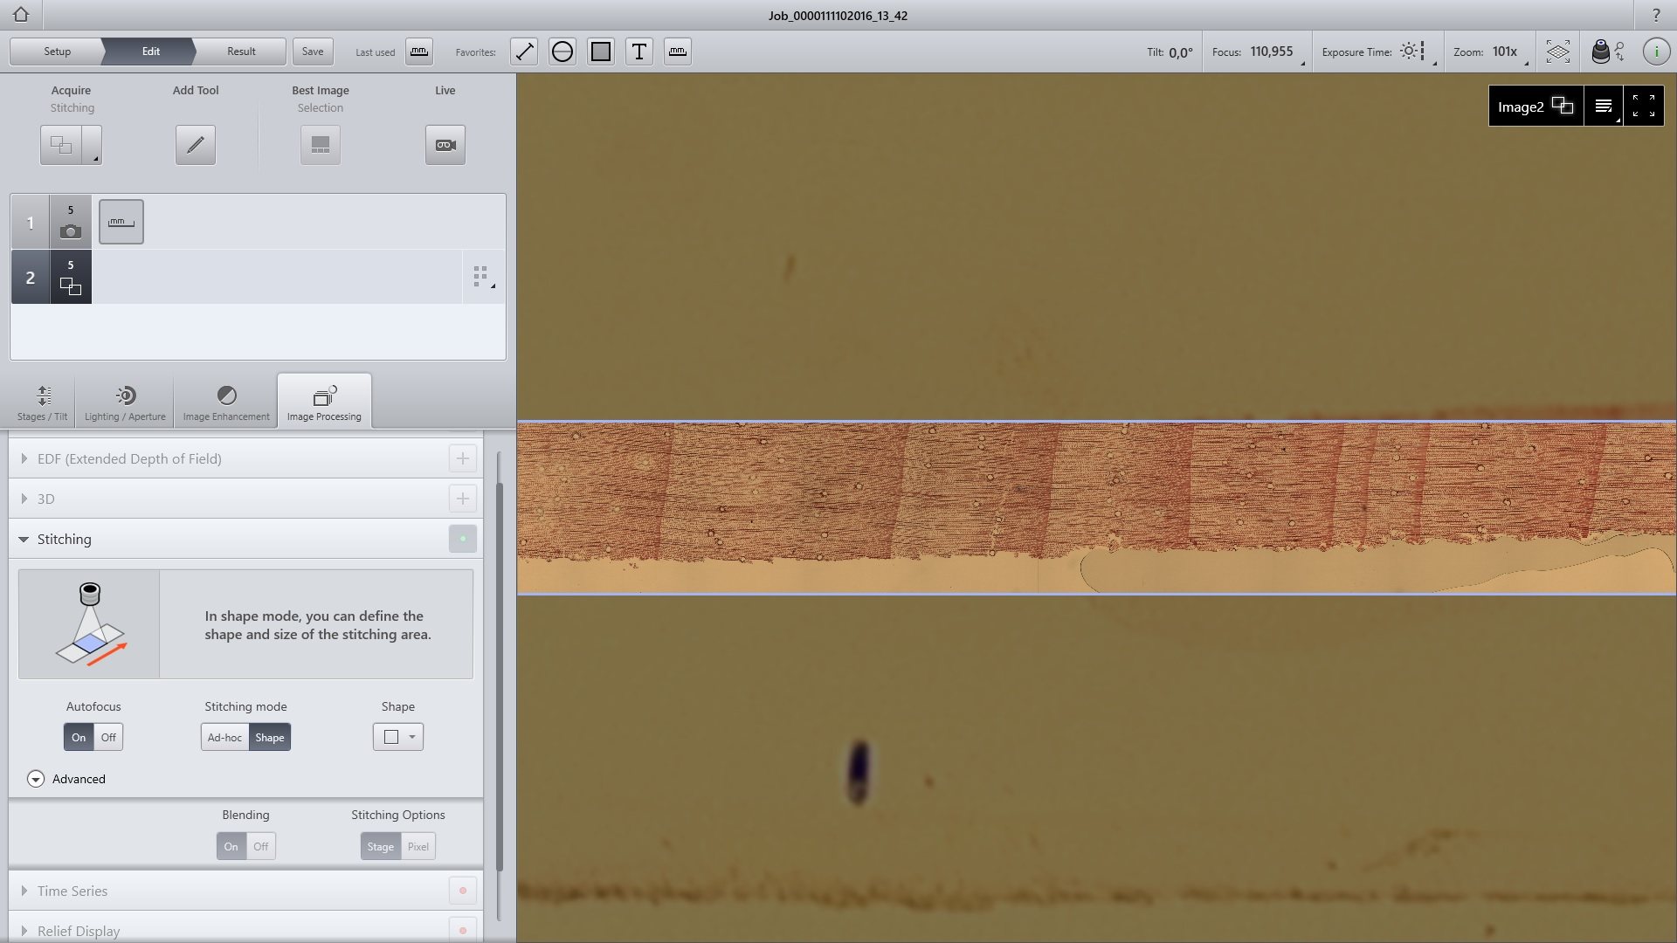
Recent Advancement of analysis methods:
Working with digital microscopes with stitching facility and image processing.

Slide 25
Recent Advancement of analysis methods:
Working with digital microscopes with stitching facility and image processing.

Slide 26
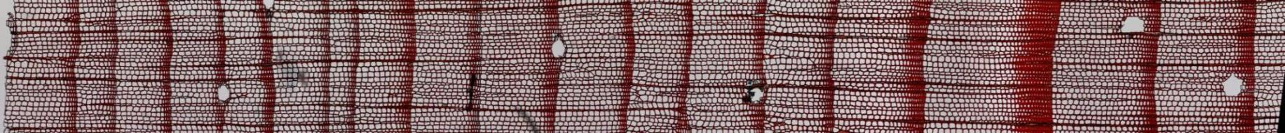
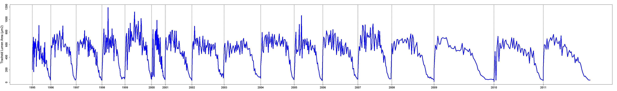
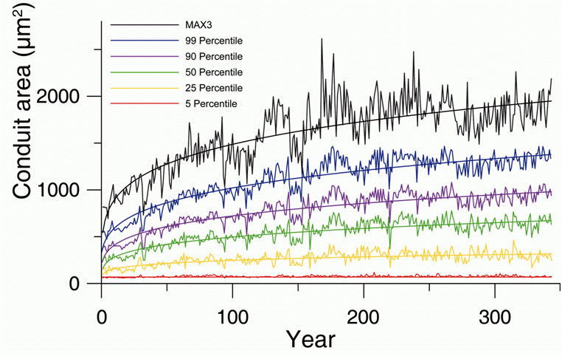
Recent Advancement of analysis methods:
Quantification of wood anatomical cell parameters with ROXAS (von Arx et al., 2014).
Courtesy by Georg von Arx
Tracheid size
Carrer et al., 2015

Slide 27
Concepts and relevance of the topic
Methodological aspects
Environmental signals in qualitative wood anatomical traits
Environmental signals in quantitative wood anatomical traits
Constraints and Challenges
Outlook and conclusions

Slide 28
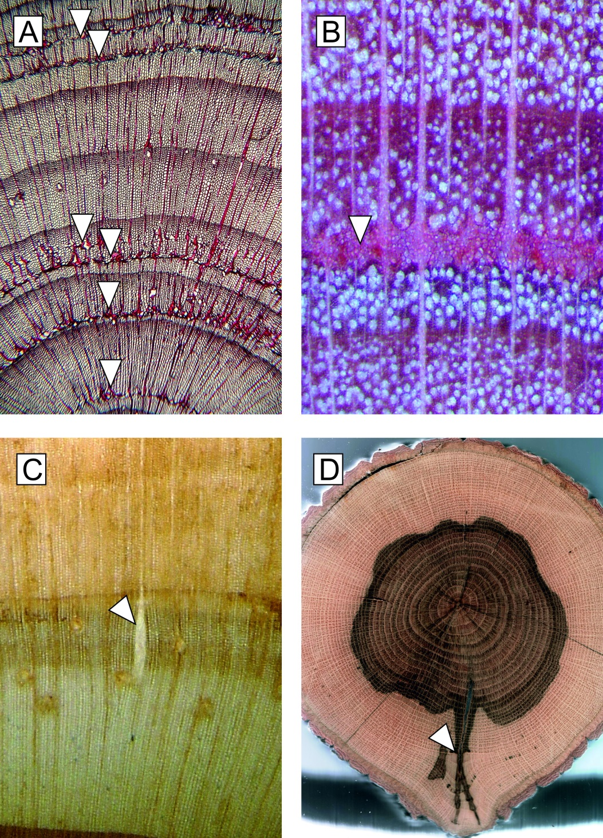
Wood anatomical features with qualitative relations to environmental factors
A: Frost rings (arrows) within Larix decidua (European Alps). Some rings show multiple frost rings indicating occurrence of late frost and/or early frost events within one growing
season.
B: Frost ring in Fagus sylvatica (Balkan Mountain range, Bulgaria).
C: Radial crack in Pinus sylvestris (Vitosha Mountains, Bulgaria).
D: Frost crack in Quercus and subsequent discolouration of sapwood and heartwood. The last tree-ring before frost crack formation is highlighted (arrow), it provides dating possibility for the event (Lakatos & Mirtchev 2014).
Bräuning et al., IAWA Journal 2016

Slide 29
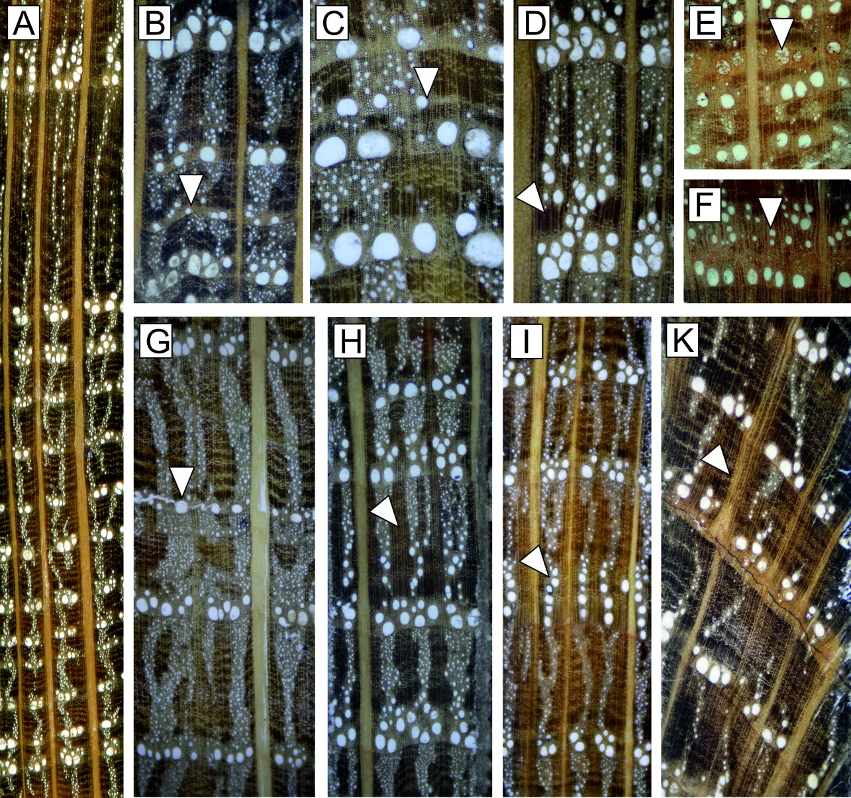
Wood anatomical features with qualitative relations to environmental factors
Special features in ring-porous oaks (Quercus sp.).
A: Variation of size, number, and/or distribution of earlywood vessels of ring-porous oak trees in different tree rings.
B: Ring with reduced earlywood vessel diameter (arrow).
C: Ring with narrow latewood followed by rings with small and few earlywood vessels (arrow).
D: Ring with complex of fibres without vessels in transitional zone from earlywood to latewood (arrow).
E: Set of few rings with tyloses within sapwood (arrow) indicating a traumatic event.
F: Double ring (arrow).
G: Latewood ring with smaller earlywood vessels (arrow).
H: Very wide rings after a growth release with large complexes of fibres (arrow).
I: Rings with earlywood vessels aligned in radial rows (arrow).
K: Modified rays after cambial wounding (arrow).
Bräuning et al., IAWA Journal 2016

Slide 30
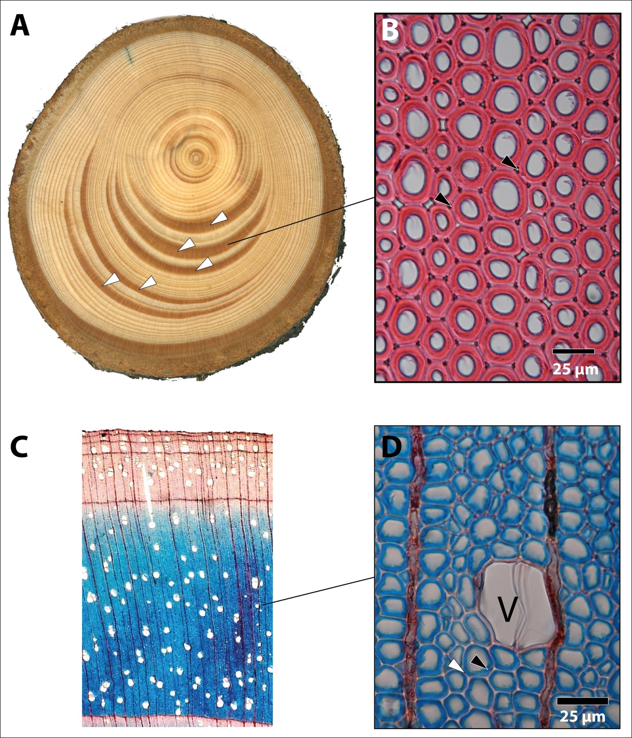
Wood anatomical features with qualitative relations to environmental factors
Reaction wood in softwoods and hardswoods
A: Compression wood in a disc of Picea abies (white arrows).
B: Section showing the anatomical structure of compression wood, tracheids are rounded showing intercellular spaces
(black arrows), the secondary walls are thick.
C: Very wide ring of Betula pendula showing tension wood (blue zone).
D: Detailed view of tension wood showing unlignified G-layers (gelatinous fibres in blue [stain: astrablue]; black arrow). The S1 + S2 layers of fibre cell walls are thin and lignified (red [stain: safranin]; white arrow). – V = vessel.
Bräuning et al., IAWA Journal 2016 (photographs by H. Gärtner)

Slide 31
Concepts and relevance of the topic
Methodological aspects
Environmental signals in qualitative wood anatomical traits
Environmental signals in quantitative wood anatomical traits
Constraints and Challenges
Outlook and conclusions

Slide 32
Quantitative analysis of wood features
Example: surface sample from diffuse porous tropical hardwood (Islam, Rahmen & Bräuning, in prep.)
Scanned image (Upper pannel) showing vessel distribution and tree-ring boundaries of Chukrasia tabularis (Meliaceae) from a moist tropical forests in Bangladesh. Lower panels show an example of vessel measurement using WinCELL program on high resolution digital microscopic image.

Slide 36
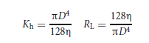
From measured parameters, physiologically, ecologically, and climatologically important hydraulic traits can be calculated.
For example, based on the Hagen-Poiseuille law, hydraulic conductivity (K_{h}) and lumen resistivity (R_{L}) can be derived:
Such parameters may be multiplied by including trait combinations with other organs (e.g. leaf traits)

Slide 37
Ring porous hardwoods
Earlywood porosity of pedunculate oak (Quercus robur)
Fonti et al.,
New Phytol., 2010

Slide 38

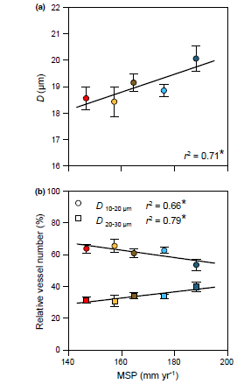
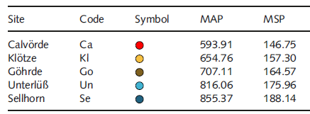
Diffuse porous hardwoods
Charactrization of xylem embolizm resistance along precipitation gradients (Fagus sylvatica)
(a) Vessel diameter (D) and
(b) percentage of vessels relative to the
total number of vessels diameter, classes 10–20 μm and 20–30 μm, in dependence on mean early summer growing season precipitation (MSP) in European beech (Fagus sylvatica).

Slide 39
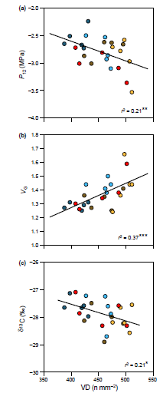
Diffuse porous hardwoods
Charactrization of xylem embolizm resistance along precipitation gradients (Fagus sylvatica)
(a) Xylem pressure causing 12% loss of hydraulic conductance (P12)
(b) vessel grouping index (VG)
(c) carbon isotope signature (δ¹³C) in relation to vessel density (VD) in European beech (Fagus sylvatica). Values are means per tree (n = 25)

Slide 40
Ring porous hardwoods
Earlywood porosity of pedunculate oak (Quercus robur)
Variance stabilized RCS chronology of ring width (RW, black) and first row of earlywood vessels (P1, grey), and their high- (wavelength b20 yr), mid- (wavelength 20–50 yr) and low-frequency (wavelength N50 yr)
components for the period 1616–2002. r-values indicate correlations between RW and P1 chronologies
Fonti et al., PPP, 2009

Slide 41
PDSI
P
T
Ring porous hardwoods
Earlywood porosity of pedunculate oak
raw
low
RW
mid
Climate-growth relationships between original, high (wavelength b20 yr), mid (20–50 yr) and low (N50 yr) frequency-components of both average monthly climate time series of previous June to current October (PDSI, 1901–2002; P and T, 1864–2002) and RCS chronologies of RW and P1
high
raw
low
P1
mid
high
Fonti et al., PPP, 2009

Slide 42




Wood anatomical studies in Mountain forests of Oriental beech (Fagus orientalis) in north Iran

Slide 43


Diffuse porous hardwoods
Relations between wood anatomical parameters of Fagus orientalis along an altitudinal gradient in the central Alborz Mountains, Iran
Pourtahmasi, Lotfiomran, Bräuning & Parsapajouh 2011

Slide 44

Diffuse porous hardwoods
Relations between wood anatomical parameters of Fagus orientalis along an altitudinal gradient in the central Alborz Mountains, Iran
Pourtahmasi, Lotfiomran, Bräuning & Parsapajouh 2011

Slide 45



Wood anatomical wood density:
Based on the ratio of cell wall thickness to cell lumen ratio (Mork‘s index)
Courtesy by Georg von Arx
Tracheid size
Cell wall thickness
Mork’s index / Thickness-to-span ratio (“anatomical density”)
Latewood
Earlywood

Slide 46


High-resolution wood anatomy
A multi-parameter tree-ring network of
Pinus nigra ssp. laricio on Corsica (trees up to 900 years old!)
Asco
1600m
Pinerole
1650m
Canereccia
1600m
Asinao
1400m
Temperate Mediterranean
climate regime

Slide 47










High-resolution wood anatomy
Classification of P. nigra latwood types and IADFs
1. Light latewood
2. Dark latewood
Normal latewood: 11 12 21 22
Broad latewood: 121 112 211 212
Special features: 1xxx (E+, latewood cells in earlywood) 22.1 (L+, after Campelo et al. 2007)

Slide 48








High-resolution wood anatomy
Correlation between frequency chronologies of latewood features with climate
Temperature
Precipitation
1
2
11
12
21
22
211
L+
Is that all we can do?

Slide 49

High-resolution wood anatomy
Latewood analysis: modified Tracheidogramm (Vaganov et al. 1990) approach
Lumen area
Cell wall width
Modelled latewood density
Radial Cell
size
Construction of chronologies for each parameter at relative latewood position 1-10

Slide 50

High-resolution wood anatomy
Latewood analysis: Mean intra-ring parameters
Lumen area
Cell wall width
Modelled latewood density
Radial Cell
size

Slide 51




High-resolution wood anatomy
Boxplots of mean intra-annual cell parameter variability in selected pointer years
1962: L+
1986: 12
1998: 211
2002: 11
2005: 2
Lumen area
Cell wall width
Radial Cell size
Latewood density

Slide 52

High-resolution wood anatomy
Latewood analysis: Intra-annual transition of individual cell parameters
Lumen area
Cell wall width
Modelled latewood density
Radial Cell
size

Slide 53

High-resolution wood anatomy
Latewood analysis: Intra-annual transition of individual cell parameters
Mean lumen area
profiles
PCA of
lumen area
profiles
Mean lumen area
profiles colored
after
their respective
factor loading
Means of
different
profile types

Slide 54

High-resolution wood anatomy
Latewood analysis: Intra-annual transition of individual cell parameters
Mean cell size
profiles
PCA of
Cell size
profiles
Mean cell size
profiles colored
after
their respective
factor loading
Means of
different
profile types

Slide 55

High-resolution wood anatomy
Latewood analysis: Intra-annual transition of individual cell parameters
Mean cell wall
width profiles
PCA of
Cell wall
width
profiles
Mean cell
wall width
profiles colored
after
their respective
factor loading
Means of
different
profile types

Slide 56

High-resolution wood anatomy
Latewood analysis: Intra-annual transition of individual cell parameters
Modeled wood
density profiles
PCA of
wood
density
profiles
Mean wood density
profiles colored
after
their respective
factor loading
Means of
different
profile types

Slide 57

High-resolution wood anatomy
Latewood analysis: Correlation of individual cell parameter chronologies with T
Lumen area
Cell wall width
Radial Cell size
Modelled density
transition wood, middle of latewood, end of latewood

Slide 58

High-resolution wood anatomy
Latewood analysis: Correlation of individual cell parameter chronologies with P
Lumen area
Cell wall width
Radial Cell size
Modelled density
transition wood, middle of latewood, end of latewood

Slide 59

High-resolution wood anatomy
Multi-parameter climate reconstruction
Inclusion of quantitative cell parameters in a multi-parameter climate reconstruction (Table shows correlation coefficients of all wood parameters with climate data)

Slide 60


Fertilization effects
A tropical mountain rainforest:
2000 mm annual precipitation, poor in nutrients
Spannl, Homeier, Bräuning, Frontiers in Geoscience, 2016

Slide 61
Fertilization effects
Characteristics of wood anatomical traits of Alchornea lojaensis.
(A) Part of a cross section of A. lojaensis from the pith to the bark. Partly distinct growth ring boundaries (GRB) are indicated by white arrows.
(B) Cross section of A. lojaensis. SV = solitary vessel, MV = multiple vessels, LF = flattened and thickened libriform fibers, WR = wood ray, AAP = axial apotracheal parenchyma;
(C) Tangential section of A. lojaensis. LF = libriform fibers, PP = perforation plate, AIP = alternate positioned intervessel pits, PPA = paratracheal parenchyma;
(D) Wood rays of A. lojaensis (radial section). URC = upright rectangular ray cells, SRC = squared ray cells;
Spannl, Homeier, Bräuning, Frontiers in Geoscience, 2016

Slide 62



Fertilization effects
Characteristics of wood anatomical traits of Alchornea lojaensis.
Spannl, Homeier, Bräuning, Frontiers in Geoscience, 2016

Slide 63
Fertilization effects
Characteristics of wood anatomical traits of Alchornea lojaensis.
Mean frequency distribution (%) of arithmetic vessel diameter classes (20 µm width) of - total number of vessels (upper panel), - solitary vessels (middle panel) and - multiple vessels (lower panel), separated into
- control group (C=grey), - nitrogen fertilized group (N = dark green), - nitrogen plus phosphorous fertilized group (N+P= light green).
Columns represent mean values of the three trees per treatment; whiskers represent the respective standard deviation.
Fertilization leads to a shift in vessel size: more larger vessels, less smaller vessels. This may enhance the risk of cavitation under drought stress.
Spannl, Homeier, Bräuning, Frontiers in Geoscience, 2016

Slide 64
Fertilization effects
Characteristics of wood anatomical traits of Alchornea lojaensis.
Ratio of area-weighted diameter (µm) and vessel frequency (N mm⁻²) of all different treatments (including a linear regression model).
Fertilization leads to a higher number of larger vessels. This may enhance risk of cavitation under drought stress.
Spannl, Homeier, Bräuning, Frontiers in Geoscience, 2016

Slide 65
Concepts and relevance of the topic
Methodological aspects
Environmental signals in qualitative wood anatomical traits
Environmental signals in quantitative wood anatomical traits
Constraints and Challenges
Outlook and conclusions

Slide 66
Challenges
Covariation among wood anatomical traits Some traits show high intercorrelations and are anatomically interrelated
Wood anatomical traits in Chukrasia tabularis in Bangladesh (Islam, Rahman & Bräuning, in prep.)
 | RW | NV | VD | TVA | MVA | TVAP | MVTD | MVRD
RW | 1
NV | .983** | 1
VD | -.513** | -.449** | 1
TVA | .920** | .921** | -.525** | 1
MVA | .637** | .637** | -.531** | .740** | 1
TVAP | .072 | .140 | .376** | .166 | .367** | 1
MVTD | .693** | .683** | -.590** | .790** | .924** | .285* | 1
MVRD | .172 | .175 | -.112 | .190 | .294* | .058 | .246* | 1
**. Correlation is significant at p < 0.01 level (2-tailed). *. Correlation is significant at p < 0.05 level (2-tailed).

Slide 67
Challenges
Principal considerations concerning the wood anatomy of a plant Traits, properties, and performance: how woody plants combine hydraulic and mechanical functions in a cell, tissue, or whole plant
To maintain a certain performance of the whole plant, alterations in one trait may be compensated by changes in another, unrelated trait (co-variation or tradeoff)
Lachenbruch & McCulloh, New Phytologist, 2014

Slide 68
Challenges
Remember the classification of P. nigra latwood types and IADFs…
1. Light latewood
2. Dark latewood
Normal latewood: 11 12 21 22
Broad latewood: 121 112 211 212
Special features: 1xxx (E+, latewood cells in earlywood) 22.1 (L+, after Campelo et al. 2007)

Slide 69
Challenges
Wood anatomical traits can have age-related effects!
Example: Age-trends of visually classified density features in Pinus nigra

Slide 70

Challenges
Frequency chronologies of 8 different tree-ring types. Grey bars show the undetrended raw frequency series, black lines the detrended frequency.

Slide 71
Concepts and relevance of the topic
Methodological aspects
Environmental signals in qualitative wood anatomical traits
Environmental signals in quantitative wood anatomical traits
Constraints and Challenges
Outlook and conclusions

Slide 72
Outlook and conclusions
Combinations of wood anatomy with other techniques and experimental approaches:
dendrometry and cambial dynamics reveal site differences in wood formation dynamics and resulting wood density
Seasonal growth patterns in expanding tree rings of Populus canadensis trees in a temperate environment, for a tree on a soil with ample water reserves during the whole growing season (blue lines in A,B) and another tree exposed to dry soil conditions in the middle of the growing season (red lines in A,B)
Steppe, Sterck, Deslauriers,
TRENDS in Plant Science 2015

Slide 73

Outlook and conclusions
Combinations of wood anatomy with other techniques:
Impact of wood formation on wood density: Modelling tracheid development based on cambial phenology
Generalized additive models (GAMs) indicate for several tree species that cell enlargement duration contributes more to wood density that a larger cell wall thickness.
Cuny et al., New Phytologist 2014

Slide 74
Some Conclusions
Anatomical-morphological anomalies in wood architecture usually occur discontinuously (frost rings, reaction wood, cracks, etc.).
The spectrum of anatomical and morphological reactions of wood is relatively limited, therefore many wood anatomical features are unspecific and ambiguous concerning the causing factor. However, some features are very specific and allow a direct linkage to environmental triggers.
Quantitative wood anatomical properties can be used in similar ways as other continuous wood parameters and provide additional climatological or ecological information (e.g. water budget).
Wood anatomical properties usually show lower Rbar and EPS than ring width, but may provide a very high seasonal resolution (1-2 months).
Wood anatomical traits provide a strong link to the physiological performance of a tree and can be combined with tree growth, stable isotopes, or tree physiological parameters in a meaningful way (from statistical relationships to physiological understanding of responses).
Wood anatomical properties have a very high temporal resolution (seasonal, weekly) and provide a stronger link to climate parameters and short-term events
The full potential of quantitative wood anatomy is just being discovered!

Slide 75
































The challenge of tree adaptation to climate is hidden behind the bark…

Slide 76
































…and wood plasticity and adaptation capability are amazing!

Slide 77

Wood structure of conifers (softwoods, example Pinus)
earlywood
Ring boundary
Bordered pits
Radial tracheid
Wood ray parenchyma
latewood
Window pits
Nultsch 1982, modified

Slide 78

Wood structure of broadleaved trees (hardwoods, example birch, Betula)
cambium
Wood fibre
Ring boundary
Accompnying cell
Sieve element
vessel (Trachea)
Ray parenchyma
Nultsch 1982, modified

